Slide 1
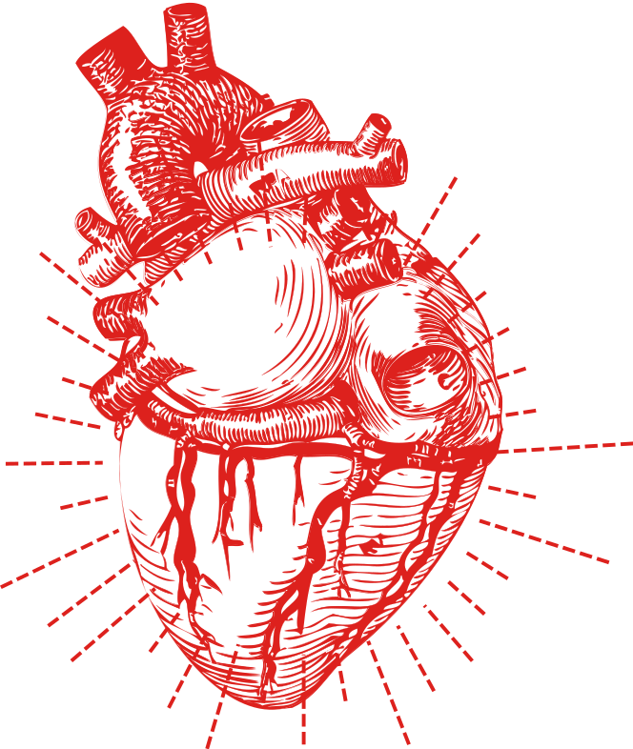
SYRACUSE UNIVERSITY
IST 707 | M402 DATA MINING
Predicting
Heart Disease
By Jake Arluck, Laura Larregui, Jacqueline Parks, and Courtney Rowland

Slide 2



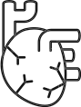
Our Motivation
Goal: Create a model to predict whether target patient has heart disease based on attribute subset.
Heart disease, including coronary heart disease, heart attack, congestive heart failure, and congenital heart disease, is the leading cause of death for both men and women in the world.
Notes:
Heart disease is the leading cause of death, etc. It’s important not to lose sight of this fact when everyone is focusing on COVID.
We’re looking at the diagnostic and demographic factors that predict heart disease risk.

Slide 3
Composition of the Patients
High Risk
45.7%
Low Risk
54.3%

Slide 4
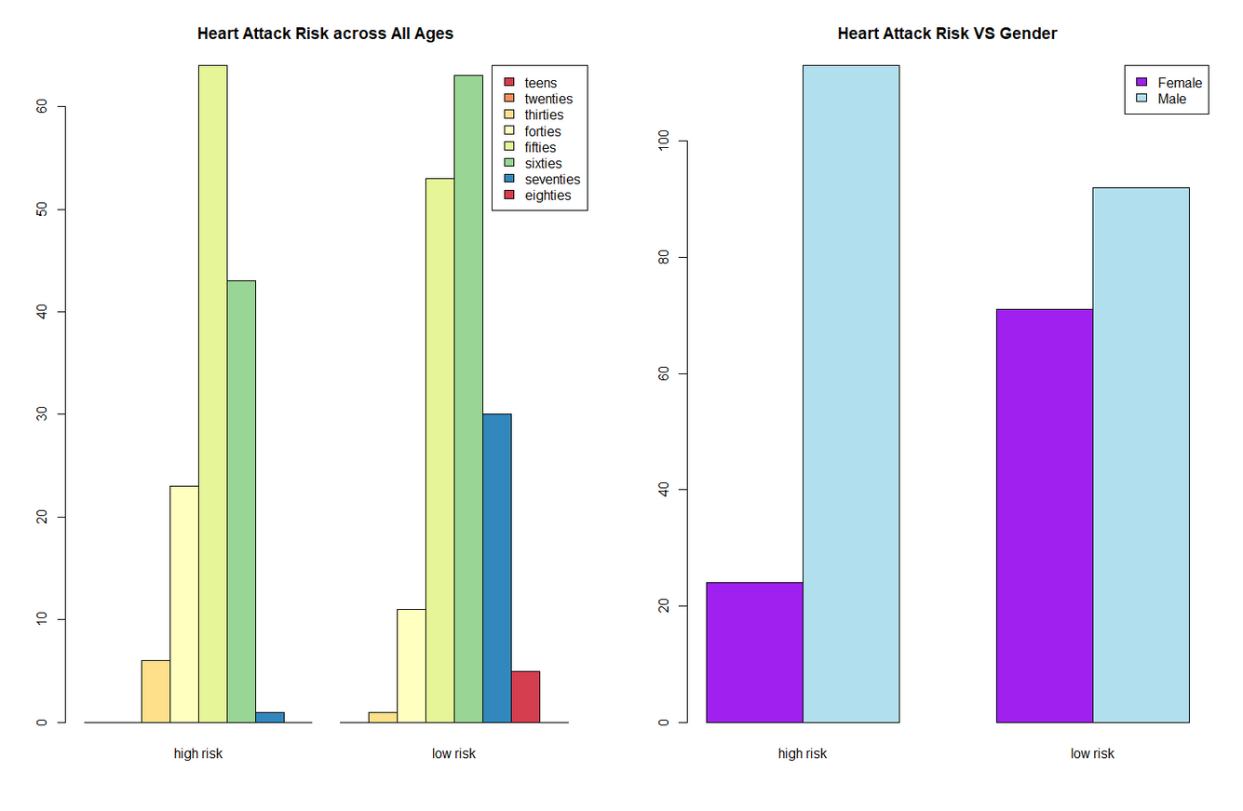
Exploratory Data Analysis
Variables: Age + Sex
Males and people between their 50s and 60s have a higher risk of heart disease.

Slide 5
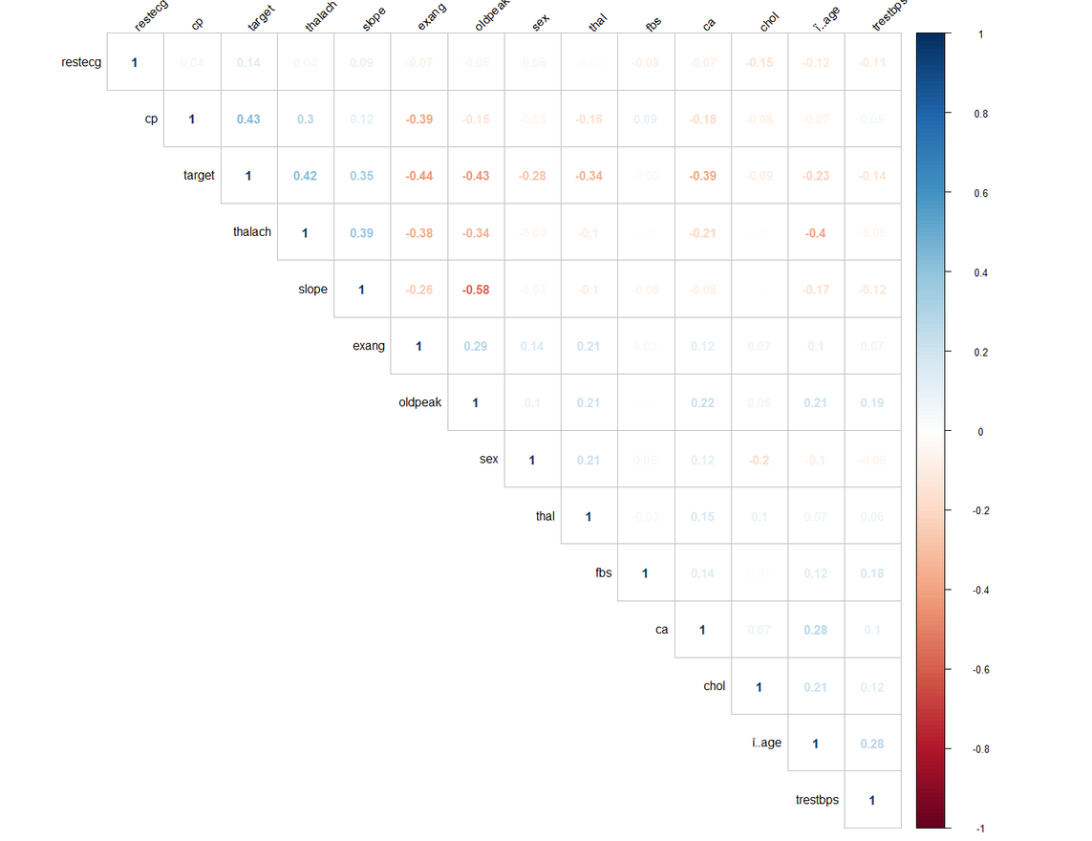
Correlation Matrix
Positive correlations are displayed in blue and negative correlations in red color.
Significant Positive Correlations: thalach, slope, cp
Significant Negative Correlations: exang, oldpeak, ca
Notes:
Our strongest positive correlations exist between our target (risk of heart disease) and cp (existence of chest pain). Other strong positive correlations include our target and maximum heart rate achieved, as well as maximum heart rate achieved and the slope of the peak exercise ST segment. Our strongest negative correlation includes the slope of the peak exercise ST segment and the ST depression induced by exercise relative to rest.

Slide 6
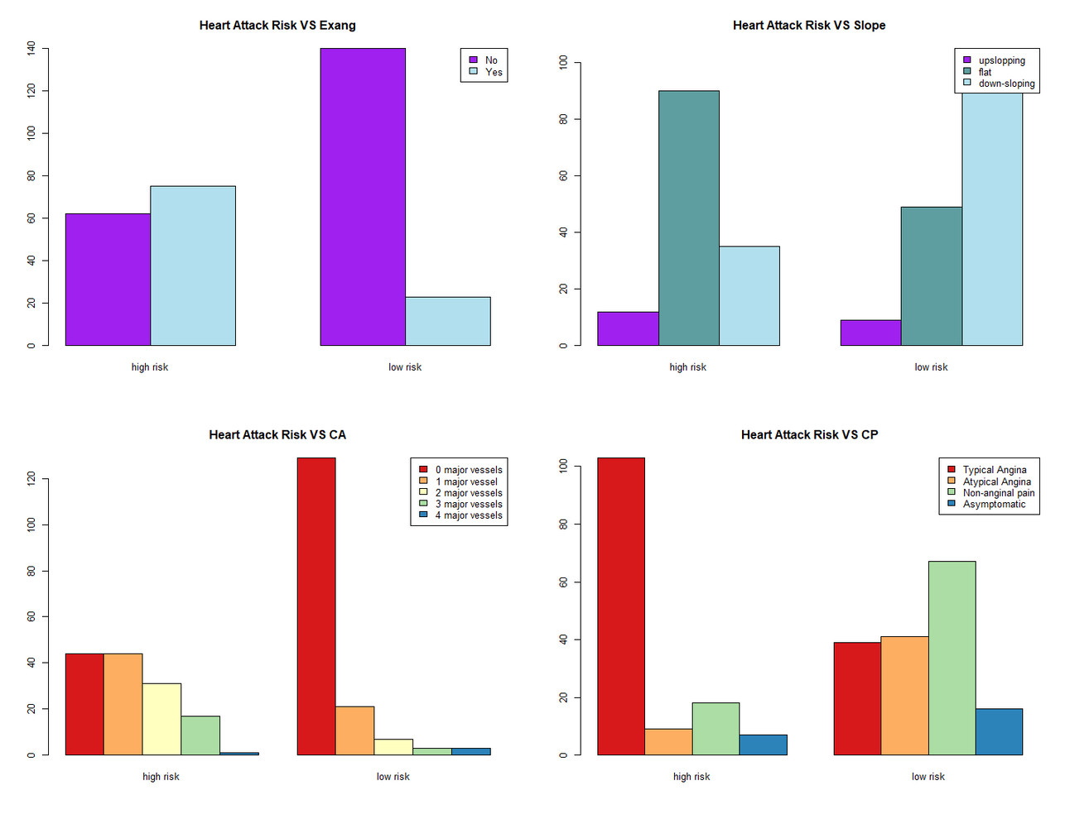
Variables with significant correlation
People with higher heart disease risk have:
Exercise induced angina
A flat slope
0-1 major vessels colored by flourosopy
Typical Angina

Slide 7

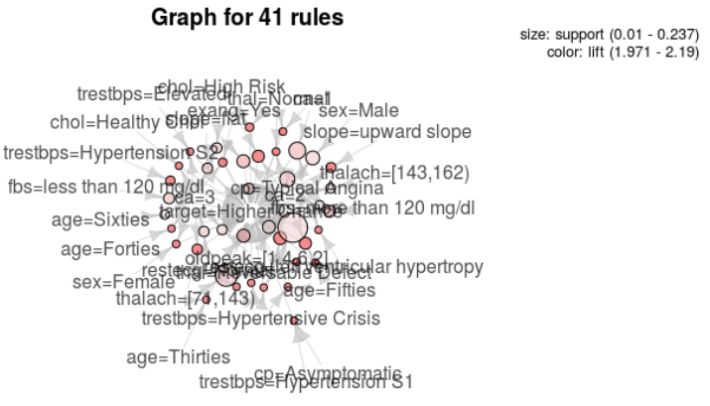
ARM
Plot of total rules mined. Many descriptive variables can be seen visually that contribute to a target patient with high risk for heart disease such as those whose cholesterol level is considered ‘High Risk’, male, ages forties/fifties/sixties, and have a resting blood pressure considered to be in hypertensive crisis upon hospital admission.

Slide 8
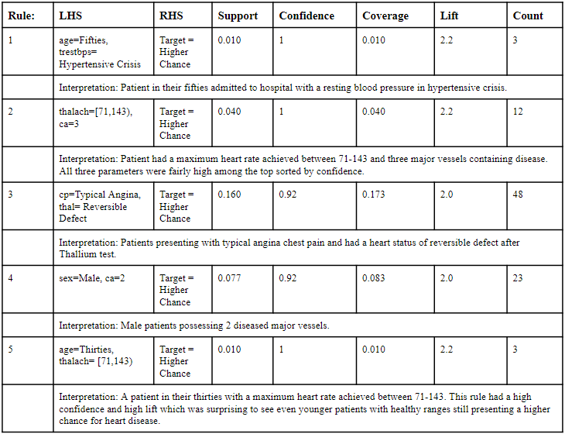
ARM: Top 5 Interesting Rules

Slide 9
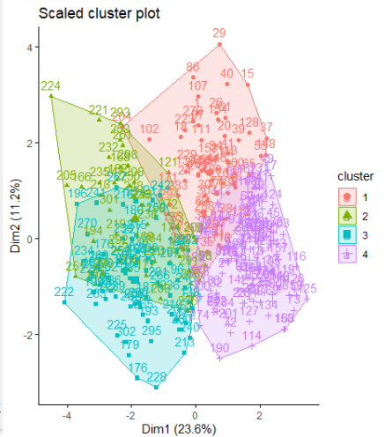
K-Means Clustering / PCA
K = 3, 4, 5 all good results
Good separation between clusters
Necessary to normalize data
Top 2 dimensions: ~⅓ of total variance.
Largest dimension corresponds very closely to overall risk - suggests existence of a “general factor of heart disease.”
2nd dimension roughly corresponds to diabetes.

Slide 10

Clustering Insights
What can we say about low-risk and high-risk clusters?
Cluster 4 has expected low-risk traits: more female, younger, low diabetes, low cholesterol.
Cluster 1 (low-medium risk) surprising: high cholesterol, ⅓ diabetic, but direct heart diagnostics (e.g. ST depression during exercise) are good. May reflect diabetics given good treatment, or else people with good genetic resistance despite unhealthy lifestyles.
Cluster 3 (highest risk) skews male (81%), but is moderate in terms of cholesterol, diabetes.
Cluster 2 (2nd highest risk) is more typical: high cholesterol, bad blood sugar, elevated exercise heart rate.
Do we need to rethink the role of cholesterol and diabetes in heart disease risk prognosis?

Slide 11

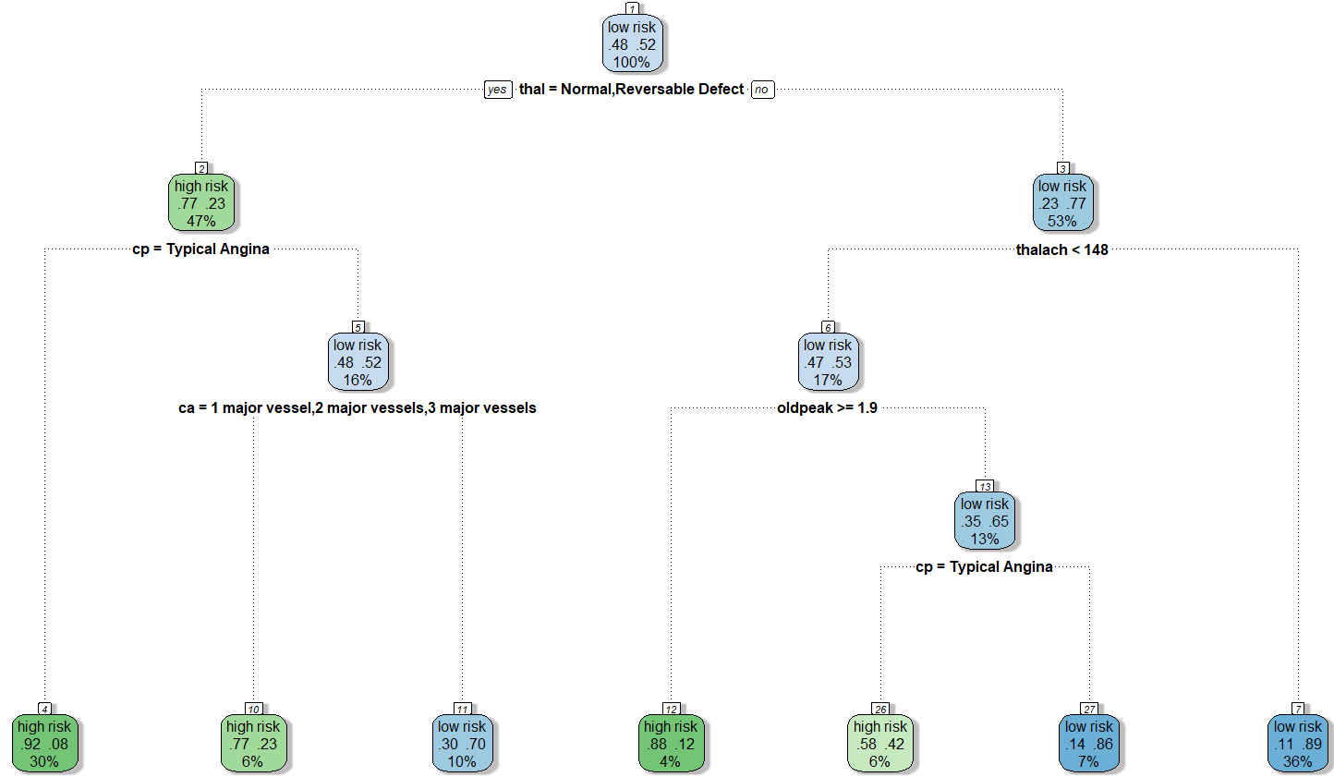
Decision Trees
Number 1
Accuracy 80%

Slide 12
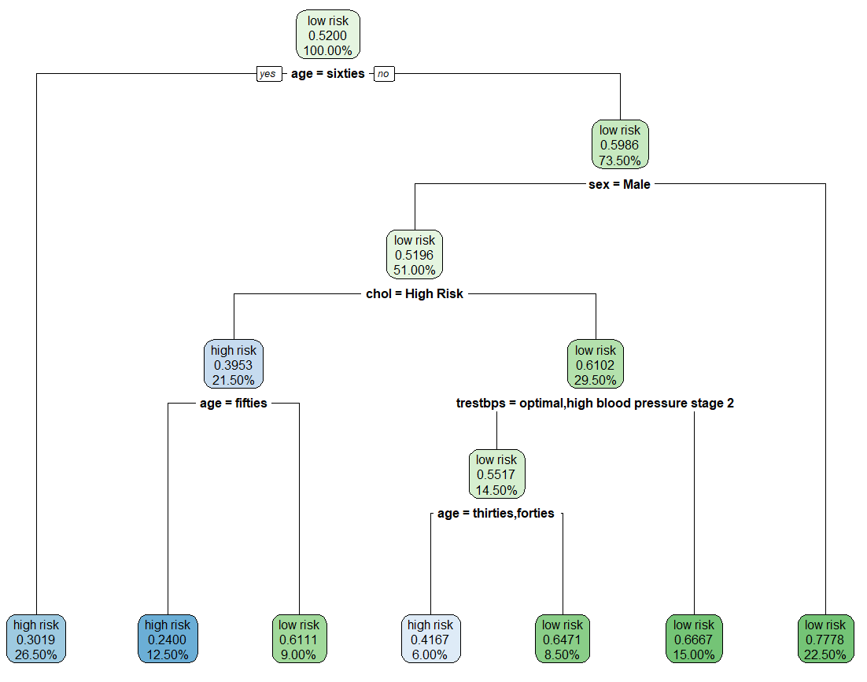
Decision Trees
Number 2
Accuracy 56%

Slide 13
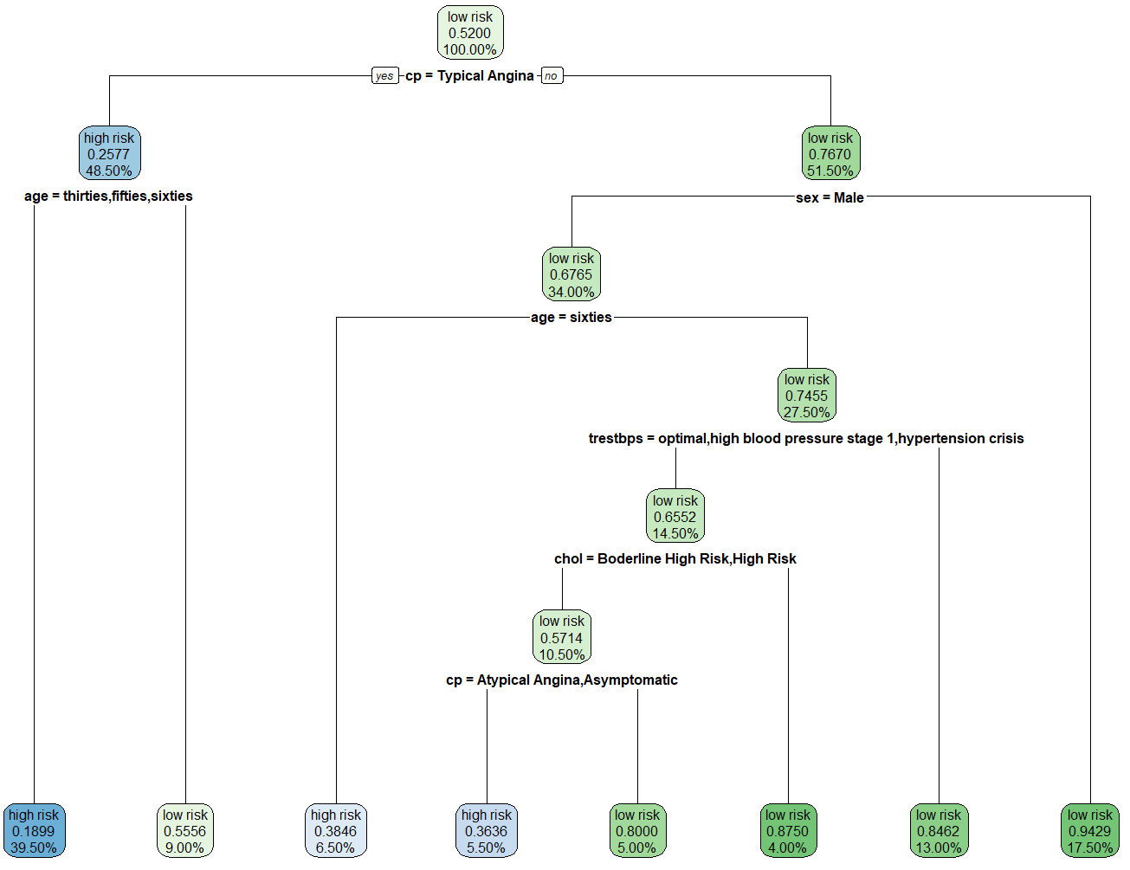
Decision Trees
Number 3
Accuracy 75%

Slide 14



88% FBS < 120 mg/d
Naïve Bayes
79% Males
75% Typical Angina
68% Reversible Defect (Thallium Test)
67% Flat Slope
Accuracy 85 %
57% High Cholesterol
44% Fifties

Slide 15
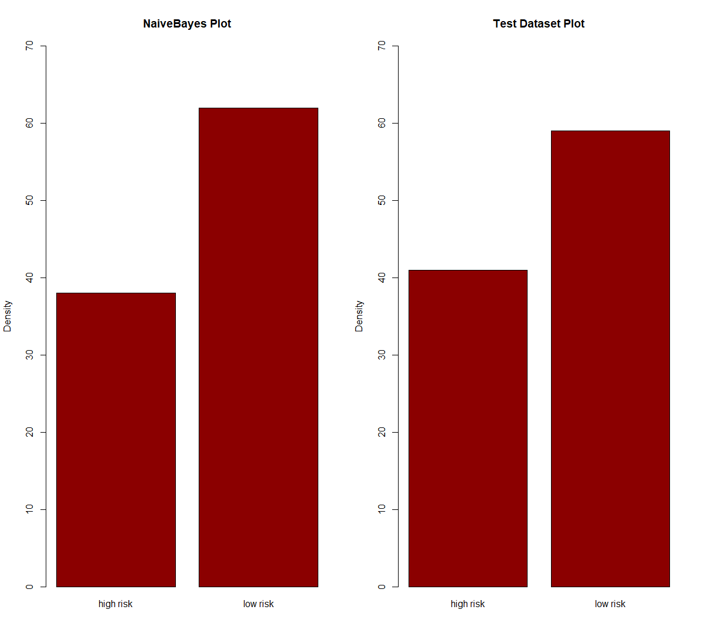
Naïve Bayes VS Test Dataset

Slide 16
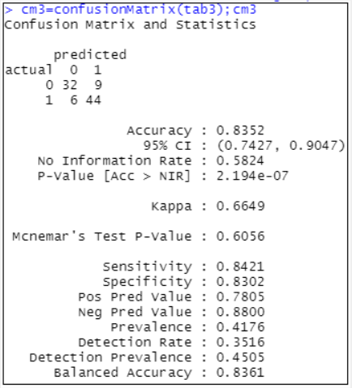
Random Forest
When running a random forest classification algorithm, we set the seed at five. Our confusion matrix resulted in a prediction accuracy of 83.52%. That is, 76 out of our 91 test data points were predicted correctly.

Slide 17
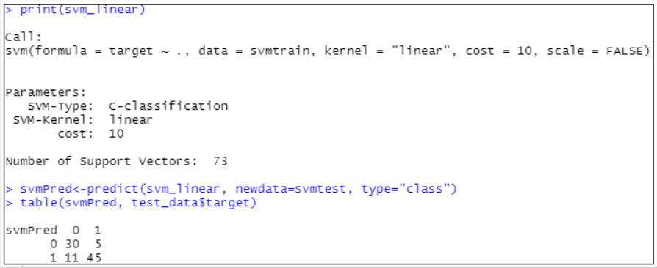
Support Vector Machine
Our support vector machine model was run using a linear kernel. The model had an accuracy of 82.42%. That is, it correctly predicted 75 out of 91 test data points.

Slide 18

Model Comparison
ARM
Naïve Bayes
Significant attributes:
Accuracy: 85%
Significant attributes:
Clustering
Random Forest
Significant attributes:
Accuracy: 83.52%
Significant attributes:
Decision Trees
SVM
Accuracy: 80%
Significant attributes:
Accuracy: 82.42%
Significant attributes:

Slide 19
Heart Disease Risk
People with higher risk of getting a heart disease have the following qualities
Variable 1
Variable 2
Variable 3
Variable 3

Slide 20




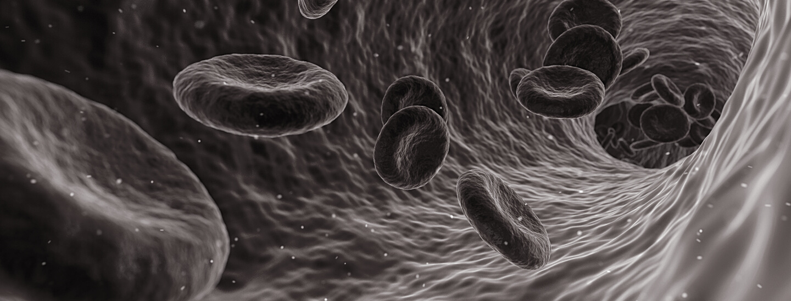
Questions?

